Slide 1
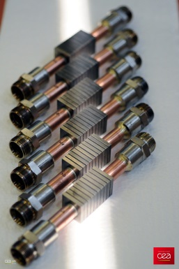
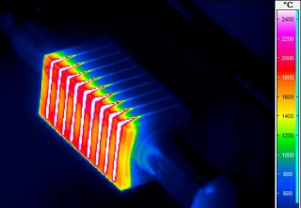
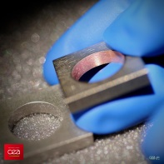
Advanced PFC successfully tested at 25MW/m²
Within the Eurofusion consortium, the WP-DIV project aims at developing plasma facing components for DEMO divertor based on W-Cu alloy materials,
In order to improve thermomechanical behaviour, an advanced concept based on a soft transition between W and CuCrZr (functionally gradient material / FGM) has been successfully designed, manufactured and tested.
The work performed by IRFM in collaboration with a French company (DEPHIS) and CEA/DRT/LITEN is divided in 3 steps:
2014
2015
2016
Conception
Fabrication
Qualification
Geometry
defined by Finite Element Modeling optimization
Fabrication of 6 mock-ups
Infrared Thermographic test (SATIR)
Ultrasonic Testing (ENEA)
High Heat flux tests (in IPP-Gladis)
Assembled Mock-ups
IR image of 25 MW/m² HHF loading (Screening)
150
FGM coating on a W tile
CEA activities
FGM interlayer
22mm
Major Result :Adequate power exhaust for FGM concept:
100 cycles at 10MW/m²
100 cycles at 20MW/m²
Screening tests at 25MW/m²
23mm
W armour
CuCrZr heat sink
New high heat flux testing and metallographic examination are foreseen in 2017 to confirm such promising results !

