Slide 1
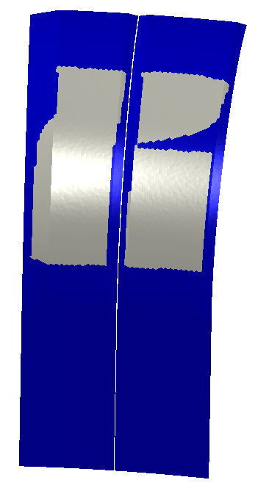
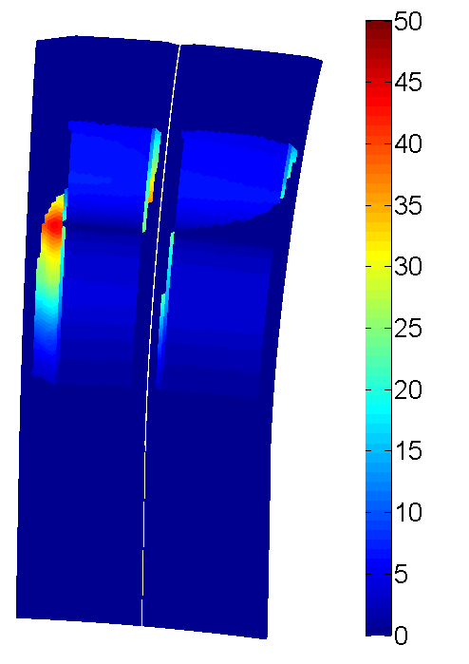
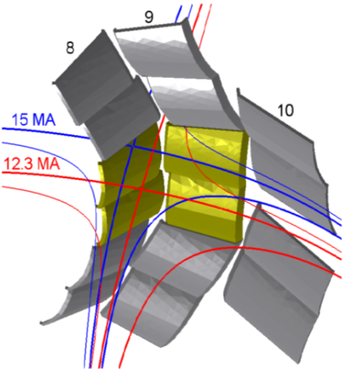
a CEA/IRFM code for the evaluation of power deposition on ITER WALLS
PFCFLUX code, developed from experiences on shadowing and heat flux simulation at IRFM, has been successfully installed and used at ITER.
First uses for ITER design studies:
Protection of the leading edges of the ITER outer vertical target during downwards VDE
Heat loads on the first wall for ICRF heating optimized plasma
Heat loads on the gaps inside the W-monoblocks
Heat loads to the upper first wall panels during the plasma ramp-down
e_{inc –chamfer max} ~ 43 MJ/m²
e_{inc} (MJ/m²)
leading edges fully protected
e_{inc –flat max} ~ 7 MJ/m²
Shadowing pattern
3D incident energy flux density distribution
PFCFLUX is now intensively used for the preparation of the coming Final Design Review of the ITER W-divertor.

